Slide 1


Books

Slide 2
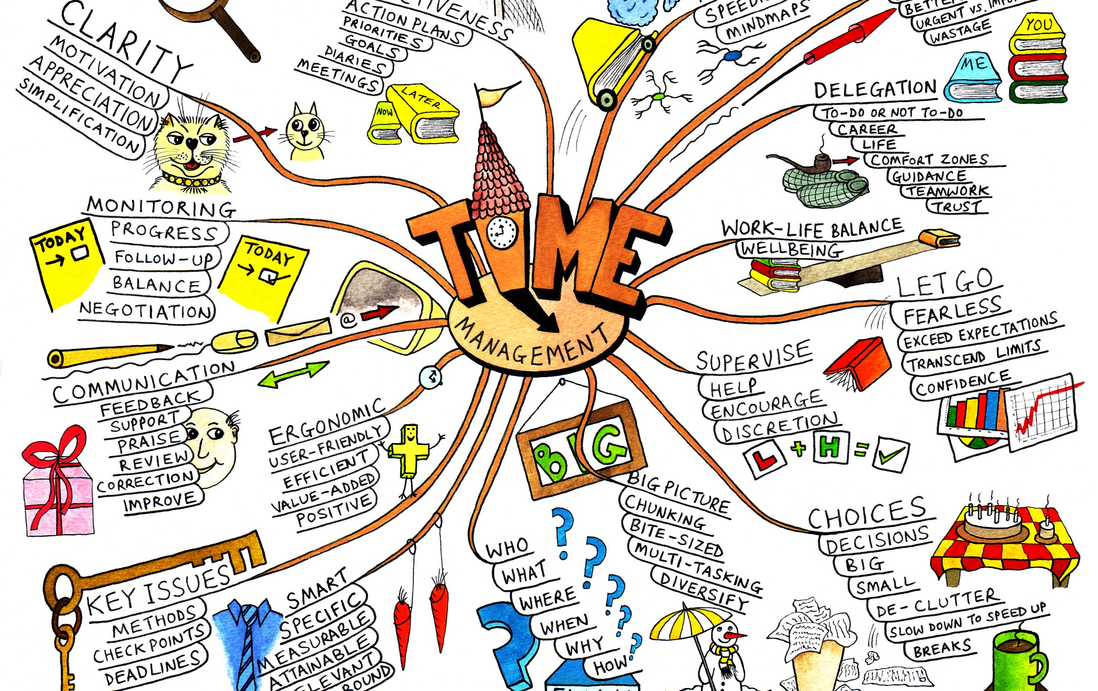
Mind Map
Due: Friday 9/16
Mind Maps are simply a way to brainstorm. For the purposes of this assignment, it will be a means of narrowing your topic for the menu project.
Brainstorm topics under the large umbrella of civil rights. What interests you? People, places, decades, and ideas are all appropriate at this stage of the process.

Slide 3
Proposal Paper
Once you have narrowed down your topic via the Mind Map assignment, it is time to write a proposal paper.
This paper should be one page, double spaced, with MLA formatting.
Discuss your chosen topic. Why did you pick it? Why is it important? How is is relevant? Why should a wider audience care about your topic?
Due: 9/22

